Slide 1
Lab-1
Mainly AI

Slide 2



What is Machine Learning?

Slide 3
Machine Learning in Real World
Identify the Problem
Classification: Do we want to bucket data into categories
Dating: Will she go on date with me?
Music: Is Metallica better than Iron Maiden?
Gaming: Whether the new e-sports team will win or not?
Regression: When we want to be precise about a numeric prediction.
Sports: Based on Erling Haaland’s past data (age, league, team, performance, location), can you predict his goals for current season?
Shopping: Gather data on items sold on Blocket (brand model, condition, description), can you predict selling price based on these factors?
Social Media: Using historical data on Tiktok (views, likes, shares, hashtags, comments, music choice, posting time), can you suggest vidoes that will go viral in Sweden?

Slide 4
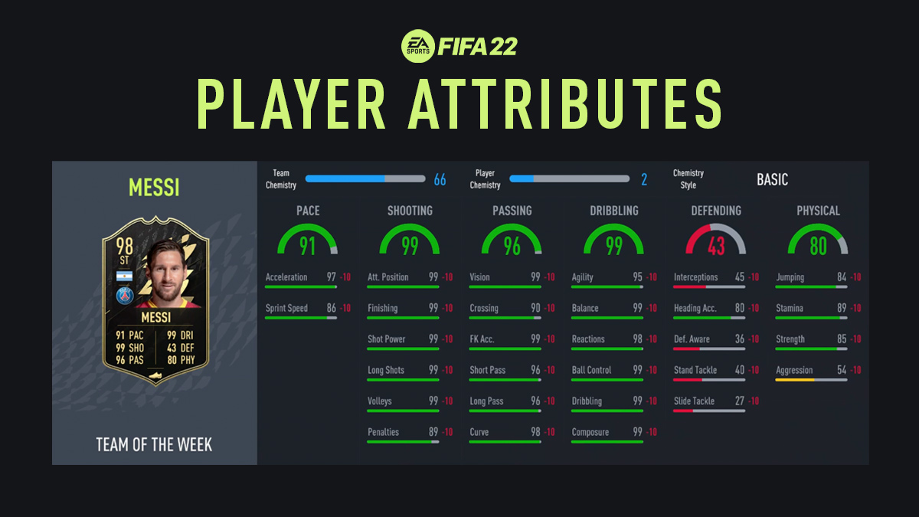
Understand the Data
Top-level view
Compare a player/Team to other players/Teams
Track performance over time
Understand your weaknesses/strengths

Slide 5
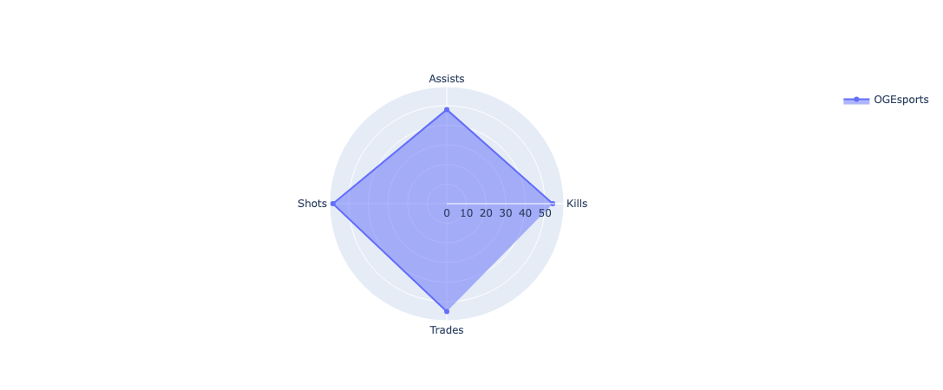
Understand the Data
Understand Player/Team Performance
Track whether a Team made improvements over time
Does Kills/Assists/Shots/Trades (KAST) score improve
over time
What features degrade over time for a team?

Slide 6
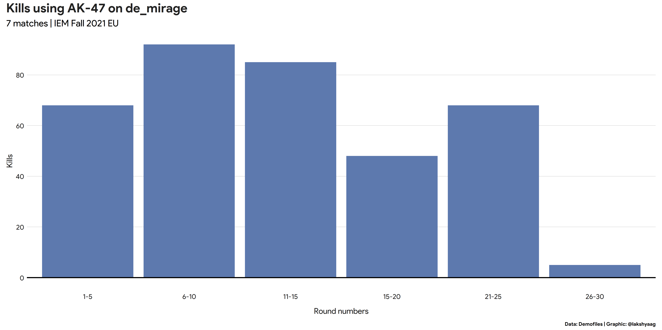
Understand the Data
Understand Player/Team Performance
Weapon Preference
How does the Kill rate differ by weapon?
Are there preferred weapons for a
specific team or player?
Are there weapons which increase
Player/Team performance?

Slide 7
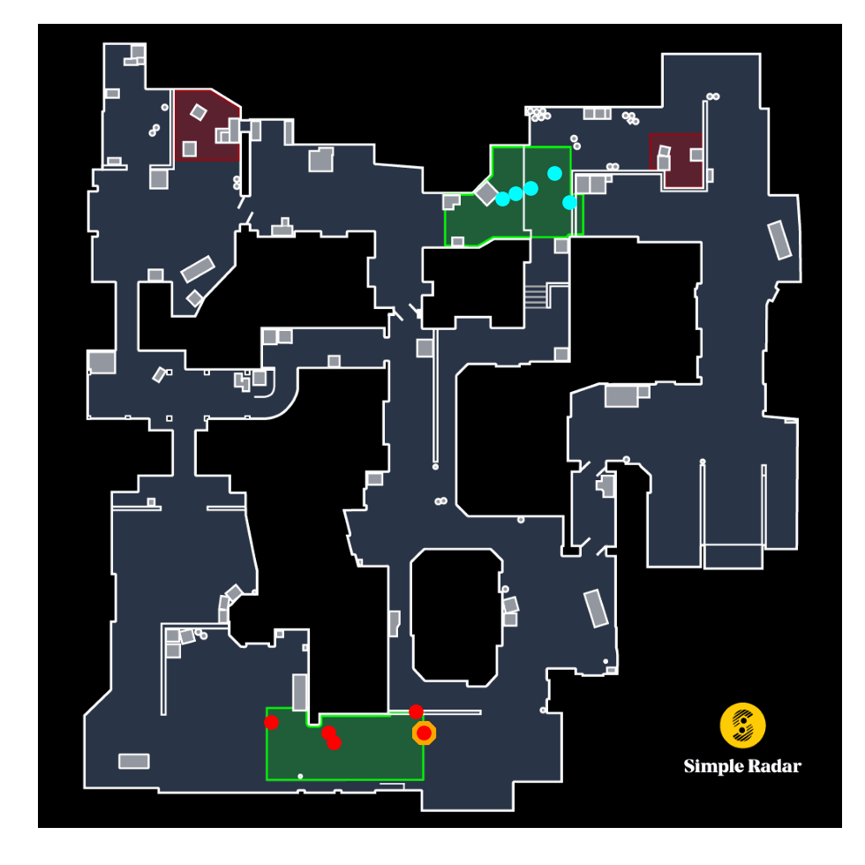
Understand the Data
Terrorists X Terrorist Killed
Counter Terrorists. X Counter Terrorist Killed
Understand Player/Team Performance
Weapon Preference
Analyze Game
Compare win rates across maps. Does your Team perform better as CT (Counter Terrorist)/T (Terrorist)?
Bombsite success rate:
Is your team able to successfully plant/diffuse against a given team?

Slide 8
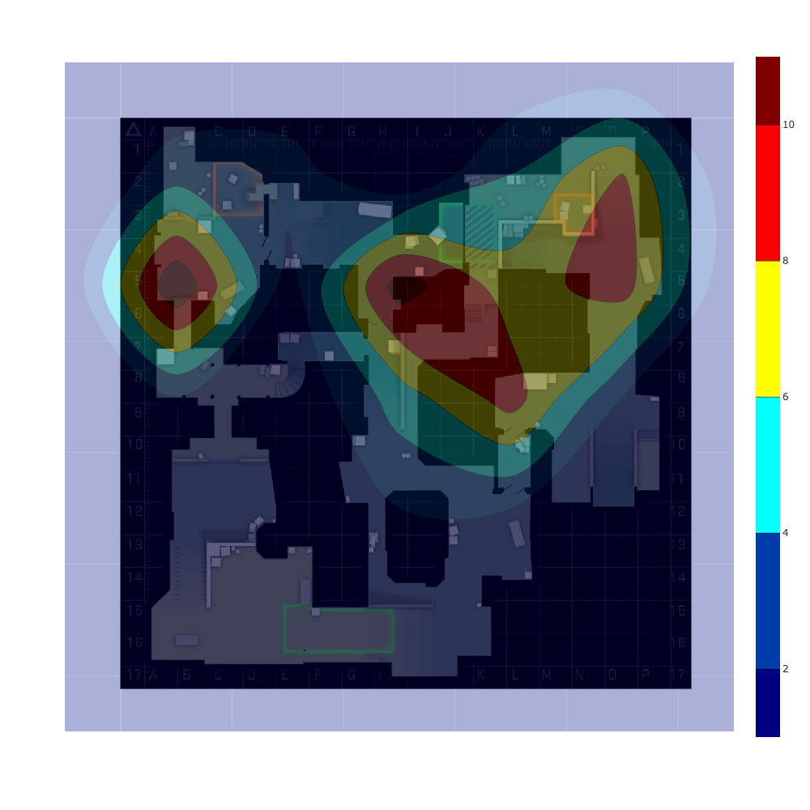
Understand the Data
Understand Player/Team Performance
Weapon Preference
Analyze Game
Compare win rates across maps. Does your Team perform better as CT (Counter Terrorist)/T (Terrorist)?
Bombsite success rate:
Is your team able to successfully plant/diffuse against a given team?
Grenade usage:
Explore usage of grenades (Smoke, Flashing, Molotov). Does your team use them effectively?

Slide 9
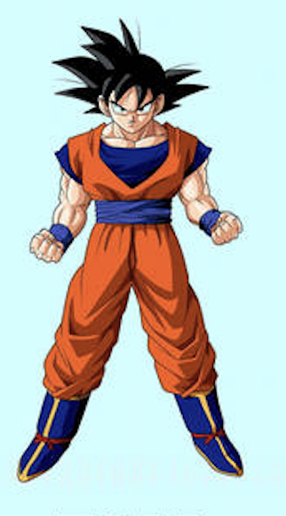
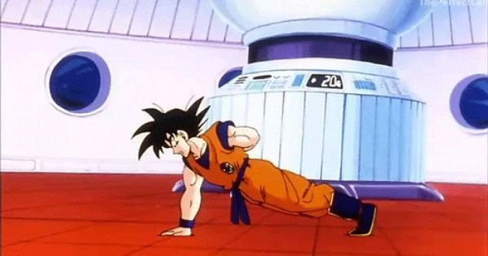
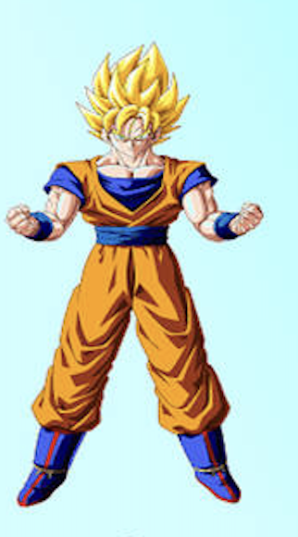
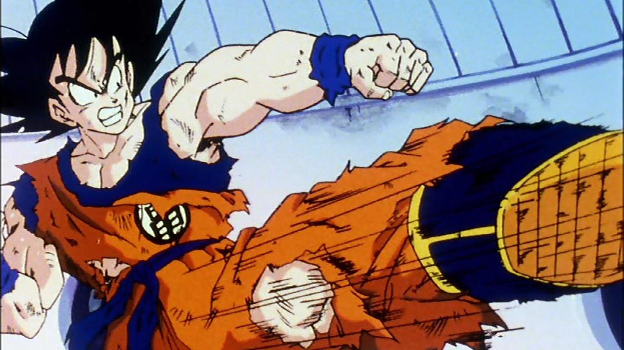
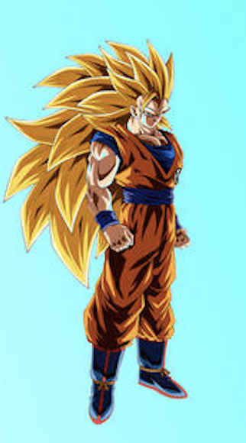

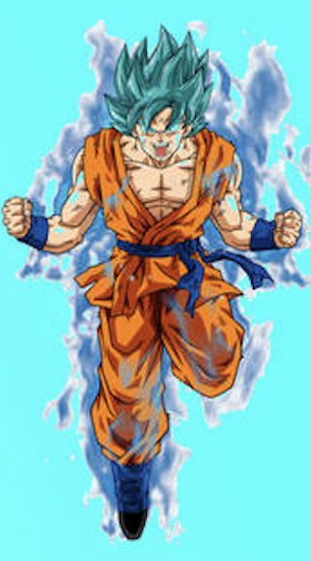



Training in Machine Learning
Basic
Model
Train
Improved
Model
Train-2
Further
Improved
Model
Train-3
Final
Model
Data
Data
Data

Slide 10
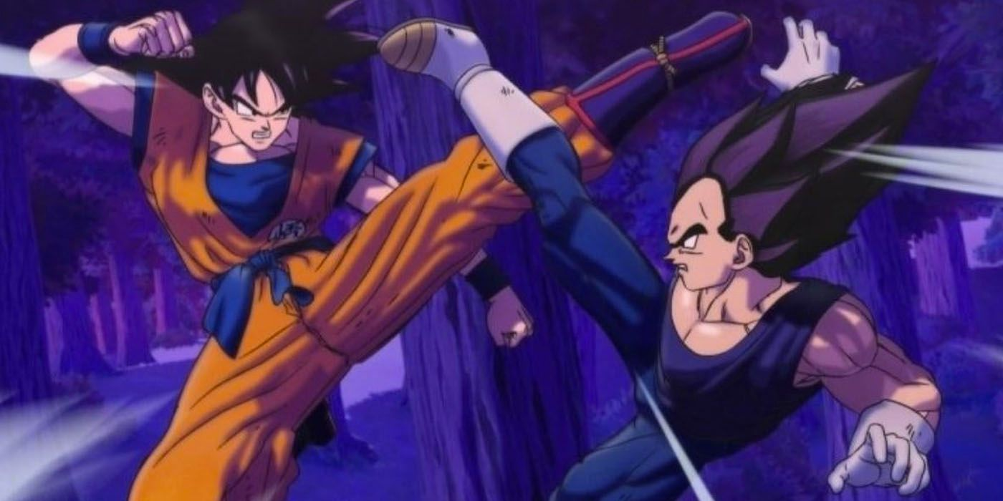
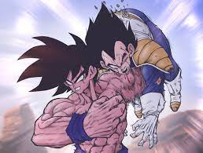
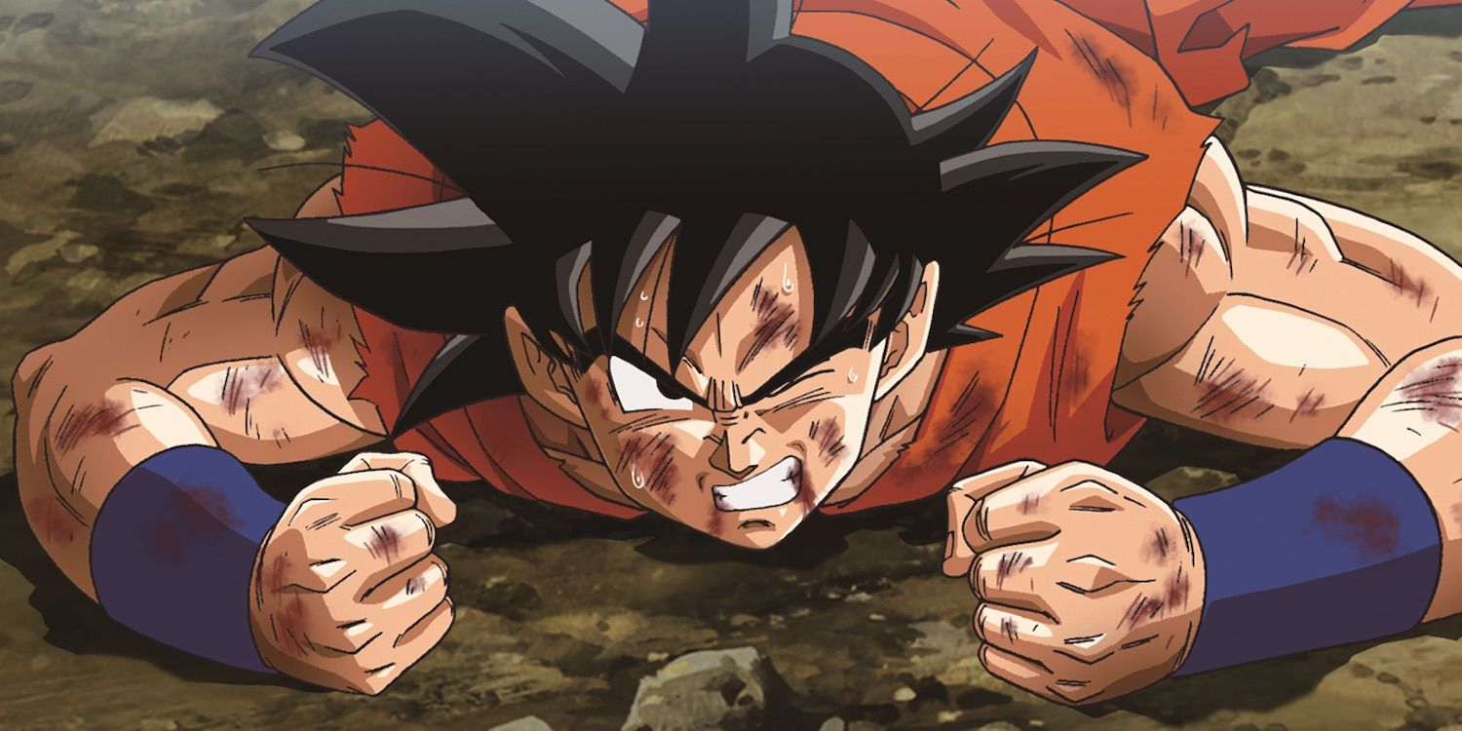
Testing in Machine Learning
Basic Model generalizing on unseen Data
Basic Model
Basic Model facing an unseen Data
Basic Model failing on unseen Data

Slide 11
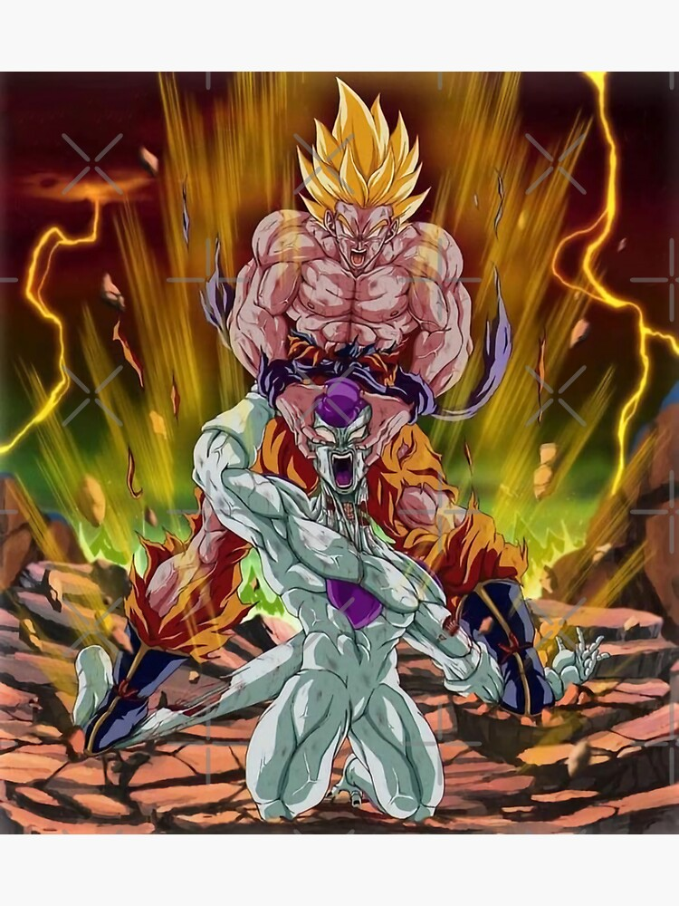
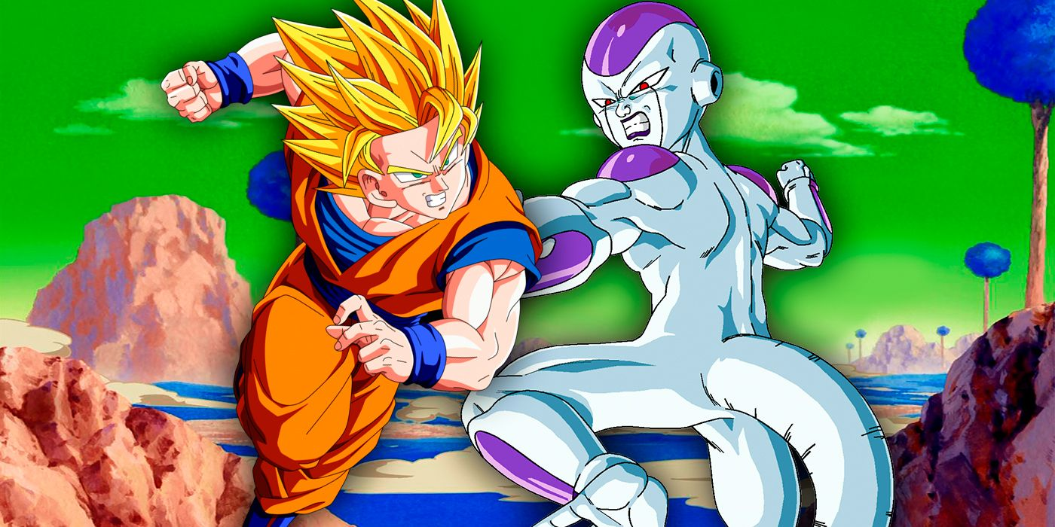

Testing in Machine Learning
Improved Model generalizing well on unseen data
Improved Model
Improved Model facing an unseen
data
Goku already fought Vegeta!
Improved Model failing on unseen data

Slide 12
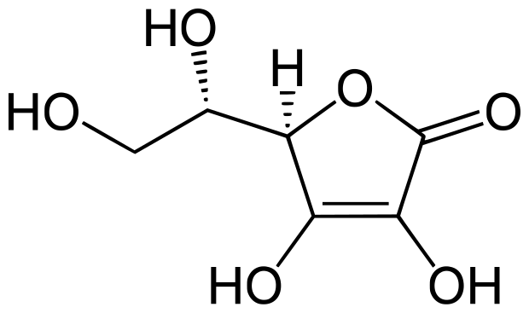
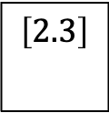
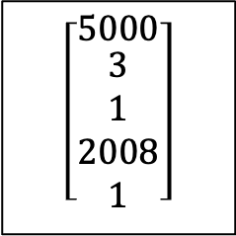
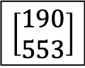
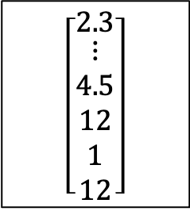
Supervised Learning
Regression
Real World input
Model input
Model
Model Output
Real World Output
5000 sq. Ft,
3 bedrooms,
Previous price 1M SEK in 2008,
1 parking spot
$$\left[\begin{matrix}5000 \\ \begin{aligned}3 \\ 1 \\ 2008 \\ 1\end{aligned}\end{matrix}\right]$$
Predicted Price is 2.3M SEK
$$\left[2.3\right]$$
$$\left[\begin{matrix}2.3 \\ \begin{aligned}⋮ \\ 4.5 \\ 12 \\ 1 \\ 12\end{aligned}\end{matrix}\right]$$
Melting point is 190⁰ C,
Boiling point is 553⁰ C
$$\left[\begin{aligned}190 \\ 553\end{aligned}\right]$$

Slide 13
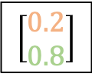
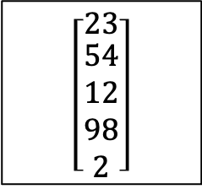
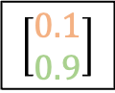
Supervised Learning
Classification
Real World input
Model input
Model
Model Output
Real World Output
The pizza was cold,the crust was soggy, and the topings were bland
$$\left[\begin{matrix}23 \\ \begin{aligned}54 \\ 12 \\ 98 \\ 2\end{aligned}\end{matrix}\right]$$
Positive
Negative
$$\left[\begin{aligned}0.2 \\ 0.8\end{aligned}\right]$$
$$\left[\begin{matrix}2.3 \\ \begin{aligned}⋮ \\ 4.5 \\ 12 \\ 1 \\ 12\end{aligned}\end{matrix}\right]$$
No-Spam
Spam
Hi,
I am a Nigerian Prince….
$$\left[\begin{aligned}0.1 \\ 0.9\end{aligned}\right]$$

Slide 14
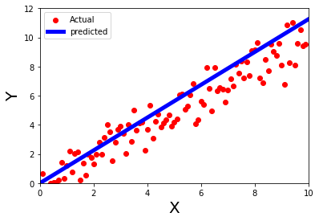

(Simple) Linear Regression Model
Problem: How precise you want to be on the task.
Say, Increase/Decrease in sales, revenue, expanditure, and by how much?
The object which we want to be precise about is our ‘Output’
‘Input’ can be based on domain knowledge, expertise, Research or even gut feeling
Y is being “explained” or “modeled”
$$Y=w⋅X$$
Target
Dependent Variable
Explained Variable
Response
Predictor
Explanatory Variable
Independent Variable
Feature
Covariate (Control Variate)
Weight
Parameter

Slide 15
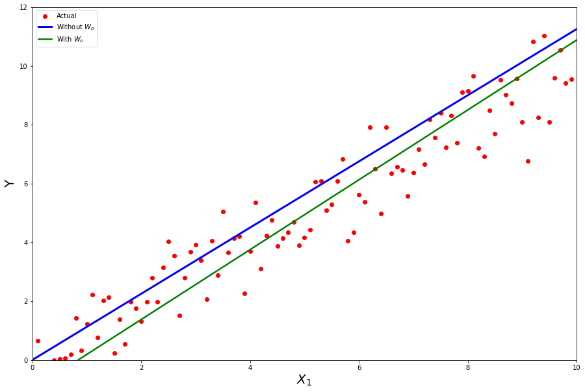
(Multiple) Linear Regression Model
Can be used to move the Regression Line
$$Y=w_{0}+w_{1}⋅X_{1}+w_{2}⋅X_{2}$$

Slide 16
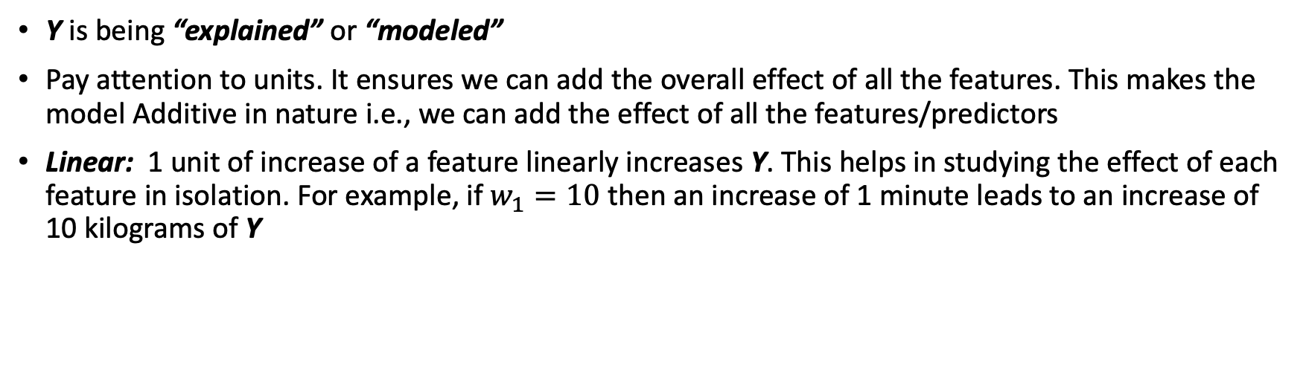
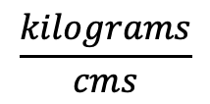
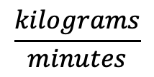
(Multiple) Linear Regression Model
$$Y=w_{0} +w_{1}⋅X_{1} +w_{2}⋅X_{2}$$
Kilograms
Kilograms
$$\frac{kilograms}{minutes}$$
minutes
$$\frac{kilograms}{cms}$$
cms
Y is being “explained” or “modeled”
Pay attention to units. It ensures we can add the overall effect of all the features. This makes the model Additive in nature i.e., we can add the effect of all the features/predictors
Linear: 1 unit of increase of a feature linearly increases Y. This helps in studying the effect of each feature in isolation. For example, if $w_{1}=10$ then an increase of 1 minute leads to an increase of 10 kilograms of Y

Slide 17
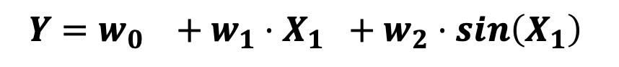
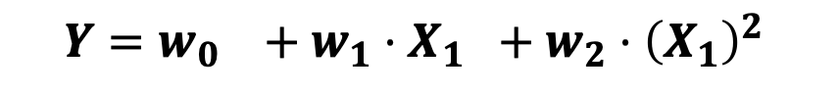
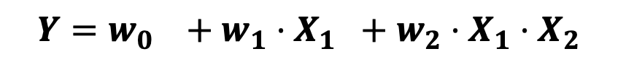
Linear Regression Model: Feature Engineering
Non-Linearity
Assuming Y is not linearly modeled by features
Cyclicity
Assuming some cycles, like yearly, quarterly etc.
Synergy/Interaction
Assuming Two terms interact with each other.
Why do we multiply?
X1 = (car, truck); X2=(low mileage, high mileage)
There are 4 possible combinations:
(Car, low mileage); (Car, high mileage)
(Truck, low mileage); (Truck, High Mileage)
$$Y=w_{0} +w_{1}⋅X_{1} +w_{2}⋅{\left(X_{1}\right)}^{2}$$
$$Y=w_{0} +w_{1}⋅X_{1} +w_{2}⋅sin\left(X_{1}\right)$$
$$Y=w_{0} +w_{1}⋅X_{1} +w_{2}⋅X_{1}⋅X_{2}$$

Slide 18

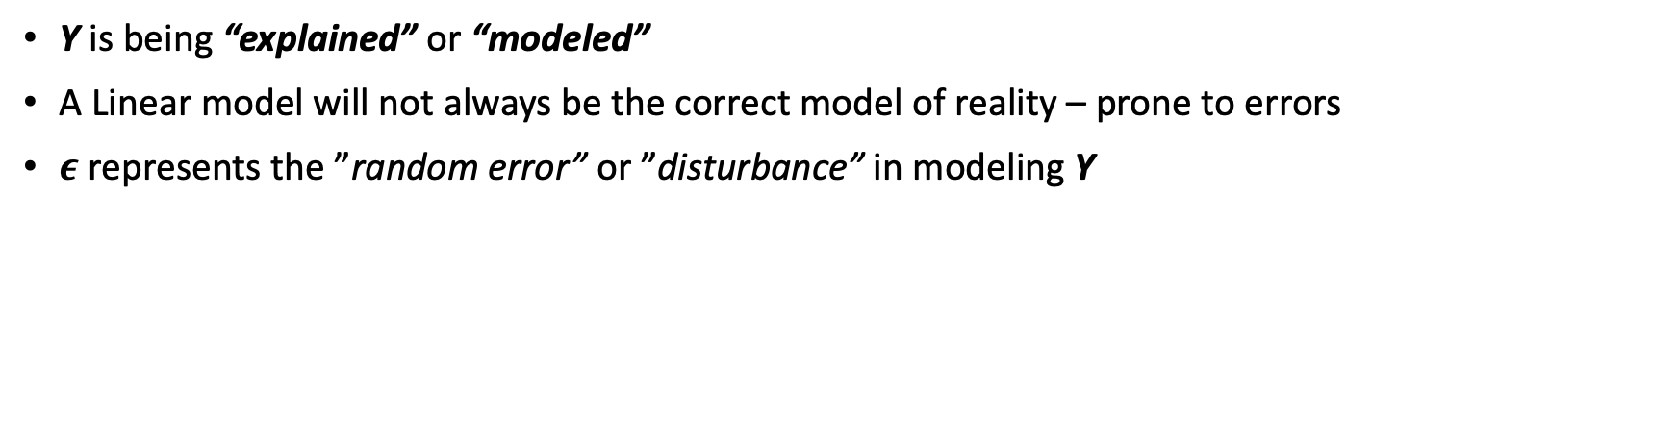

(Multiple) Linear Regression Model
$$Y=w_{0} +w_{1}⋅X_{1} +w_{2}⋅X_{2}+ ϵ$$
Error
$$\hat{Y}$$
Y is being “explained” or “modeled”
A Linear model will not always be the correct model of reality – prone to errors
$ε$ represents the ”random error” or ”disturbance” in modeling Y

Slide 19
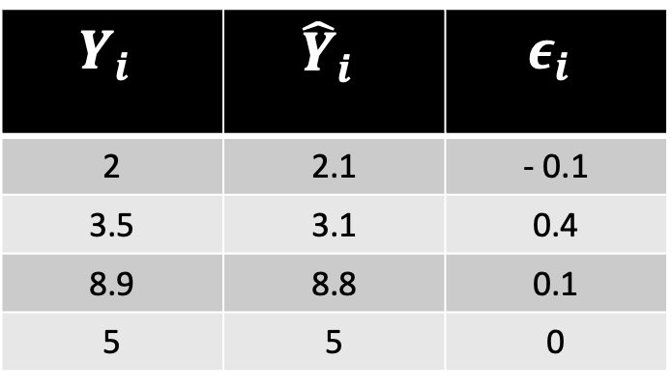
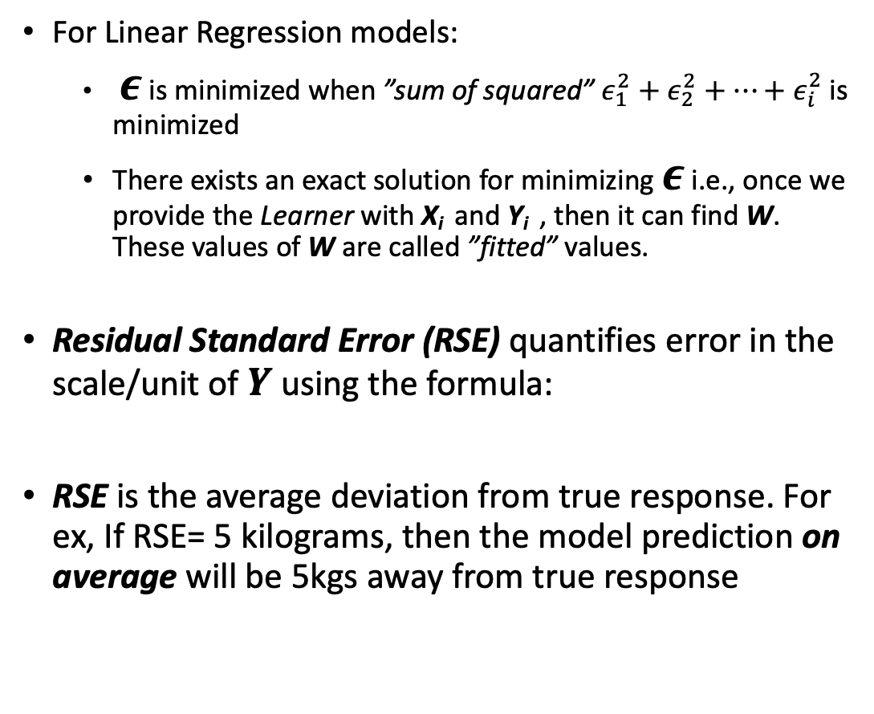
Model Assessment
$$Y_{i}$$ | $${\hat{Y}}_{i}$$ | $$ε_{i}$$
2 | 2.1 | - 0.1
3.5 | 3.1 | 0.4
8.9 | 8.8 | 0.1
5 | 5 | 0
For Linear Regression models:
$ε$ is minimized when ”sum of squared” $ε_{1}^{2}+ε_{2}^{2}+⋯+ε_{i}^{2}$ is minimized
There exists an exact solution for minimizing $ε$ i.e., once we provide the Learner with X_{i} and Y_{i} , then it can find W. These values of W are called ”fitted” values.
Residual Standard Error (RSE) quantifies error in the scale/unit of $Y$ using the formula:
RSE is the average deviation from true response. For ex, If RSE= 5 kilograms, then the model prediction on average will be 5kgs away from true response

Slide 20
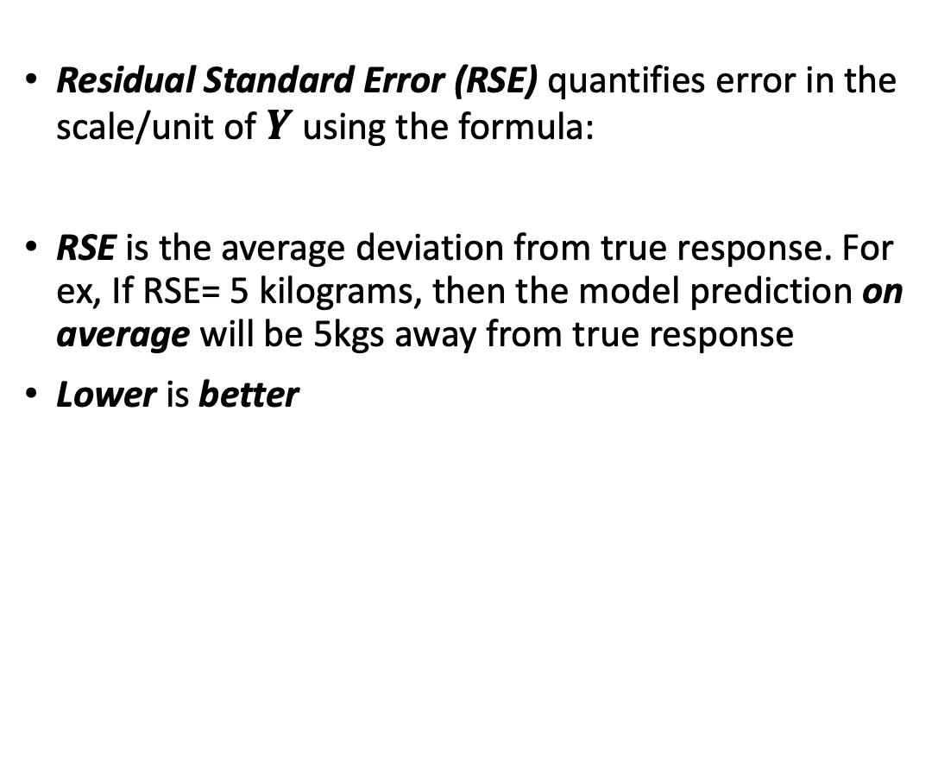
Model Assessment
$$Y_{i}$$ | $${\hat{Y}}_{i}$$ | $$ε_{i}$$
2 | 2.1 | - 0.1
3.5 | 3.1 | 0.4
8.9 | 8.8 | 0.1
5 | 5 | 0
Residual Standard Error (RSE) quantifies error in the scale/unit of $Y$ using the formula:
RSE is the average deviation from true response. For ex, If RSE= 5 kilograms, then the model prediction on average will be 5kgs away from true response
Lower is better

Slide 21
Model Assessment (Quiz)
Problem: We want to predict Sales (in units) of the next ”Call of Duty” based on the no. of Social Media posts. Two Data Scientist, one a game freak and another a stats nerd build Linear Regression Models. Which Model should you choose based on the RSE?
Game Freak Data Scientist’s RSE: 9400 units
Stats Nerd Data Scientist’s RSE: 3000 units
Problem: We want to predict Sales (in units) of the next ”Call of Duty” based on the no. of Social Media posts. Two Data Scientist, one a game freak and another a stats nerd build Linear Regression Models. Game Freak Data Scientist uses 3 features, whereas Stats Nerd Data Scientist uses 100 features. Which Model should you choose based on the RSE?
Game Freak Data Scientist’s RSE: 3100 units
Stats Nerd Data Scientist’s RSE: 3000 units

Slide 22
Model Assessment
R² : Goodness of Fit
Accounts for proportional variability in Y explained by X
Always lies between 0 and 1
RSE was in unit of Y, but R2 is not. Simplicity!
Higher is better (Unlike RSE!)
Mnemonic: RSE is low, R-square is high. A reliable model you will spy (Courtesy of ChatGPT)
Quiz: Two Business Analysts competing for promotion have built demand forecast model using Supply-Chain data. Both claim to their boss that their model is superior than the other. Boss asks them to present their model results. Based on the results, who should get promoted?
First Business Analyst:- RSE = 1 million units, R² = 0.56
Second Business Analyst:- RSE = 1.2 million units, R² = 0.85

Slide 23
Model Assessment
It is possible that a certain set of features fit the data by chance. How to assess whether the Learner has learnt patterns and rules that actually exist
Significance Tests: A test to assess whether a pattern learnt by the Learner actually exists!
Significance Tests consists of Hypotheses
Each hypothesis can be seen as a rule we want to reject (Null Hypothesis) or accept (Alternate Hypothesis)
In case of Linear Regression, F-statistic is a common test.
Generally, F-statistic should be higher than 1. Higher the better
Whether F-Statistic is significant or not is decided by its p-value
Usually, p-value below 0.05 is sufficient to reject the null hypothesis
Mnemonic: If p-value is low, Null Hypothesis must go
Pattern 1: Sales = W₀+ (W₁* Revenue) + (W₂* Advertisement)
Pattern 2: Sales = W₀+(W₁* Revenue)+ (W₂* Month) + (W₃* Location)

Slide 24
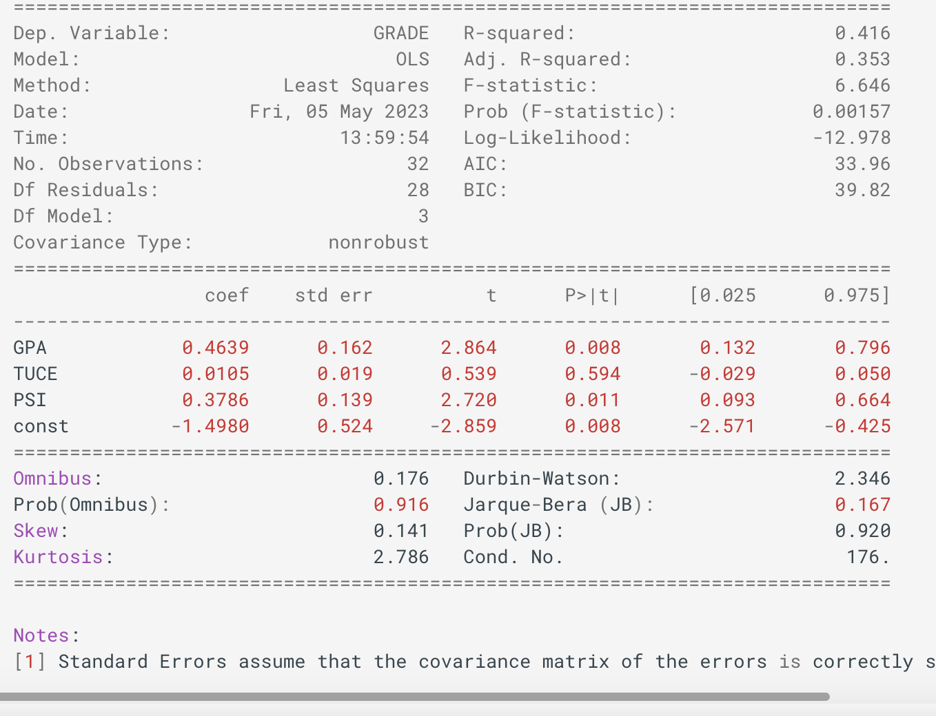
Model Assessment
Dep. Variable = Y = GRADE
Independent Variables:
GPA, TUCE, PSI
No. Observations = No of rows
Df Model = No of columns (considered for modeling)
R-squared = R²
Prob (F-statistic) = p-value of F-statistic
coef = Weight/Parameter for the features
coef for GPA is 0.4639 ie., all else constant an increase of 1 in GPA results in an increase of GRADE by 0.4369
Image Source: https://www.statsmodels.org/stable/regression.html#results-classes

